Slide 1

Electricity Usage Patterns
IOT Analytics
Brian Mattis

Slide 2
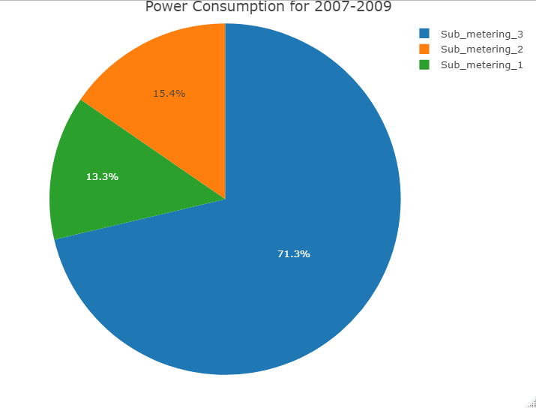
Overall Power Consumption by Submeter (2007-2009)
Residence circuit allocations
Submeter 1: Kitchen
Dishwasher
Oven
Microwave
Submeter 2: Laundry Room
Washing Machine
Dryer
Refrigerator
Light
Submeter 3: Heating/cooling
Water heater
Air Conditioner

Slide 3
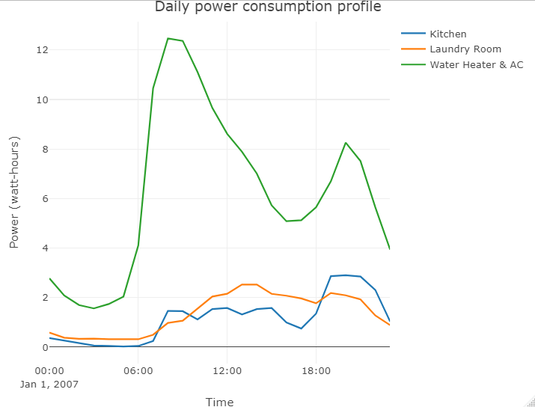
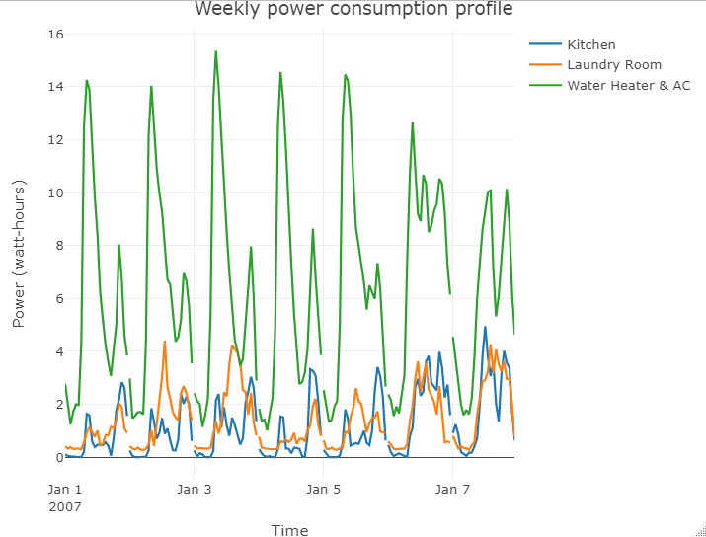
Daily and Weekly Power Usage Profiles
Dinner?
Breakfast?
Sunday
Monday
Tuesday
Thursday
Friday
Saturday
* Power data averaged hourly for all days from 2007-2009
Wednesday
Client daily and weekly behavior patterns can be observed
* Power data averaged hourly for all days from 2007-2009, by day-of-week

Slide 4
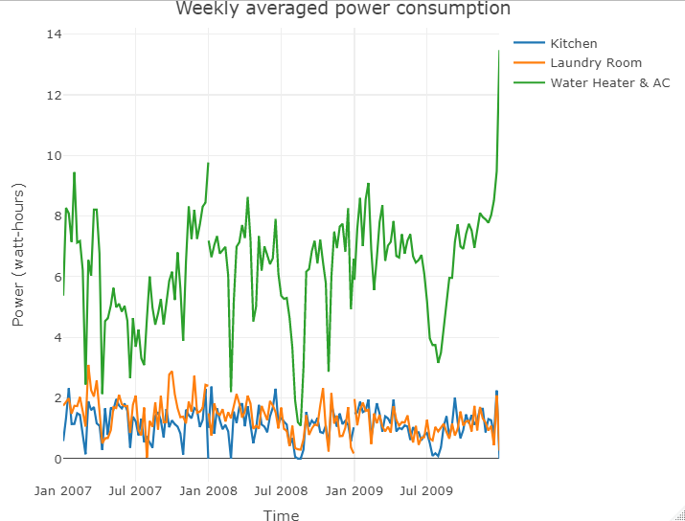
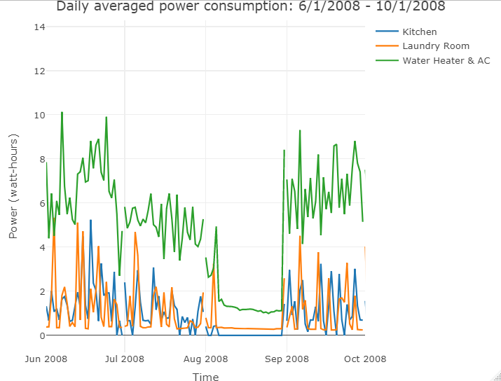
Summer 2008 Investigation
Clear data showing minimal power usage Aug 7th – Aug 30th 2008
Reasonable to conclude client was not living in residence at this time

Slide 5
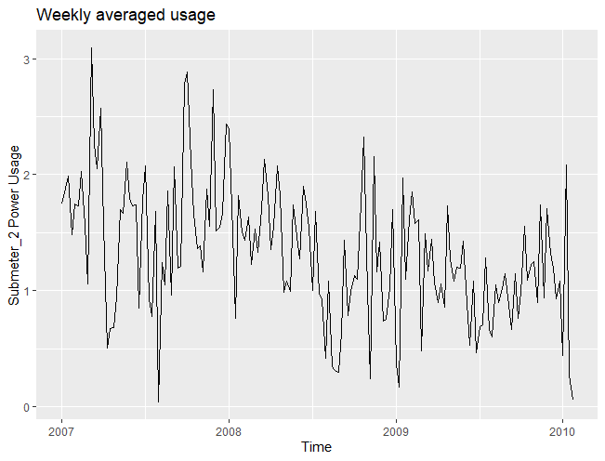
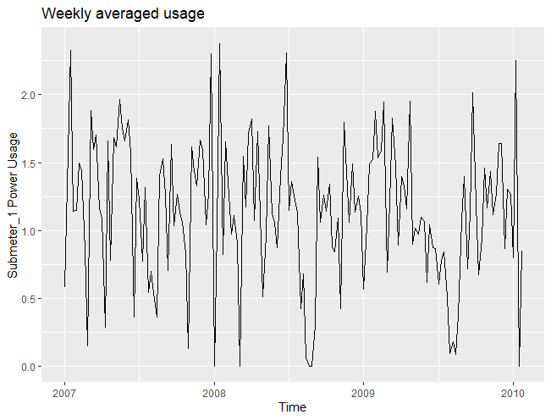
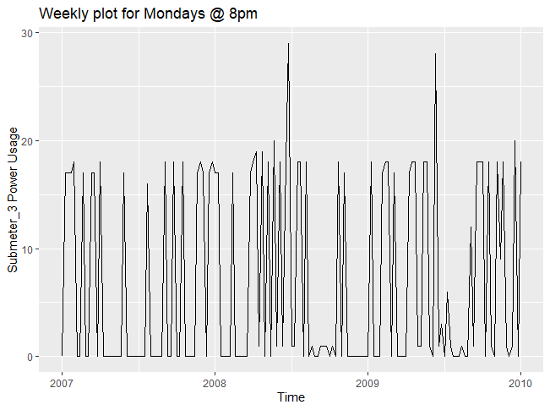
Usage data
SM1 and SM2 plotted as weekly mean usage from 2007-2010
SM3 plotted as weekly sample of the data taken at 8pm on Mondays (per project roadmap)

Slide 6
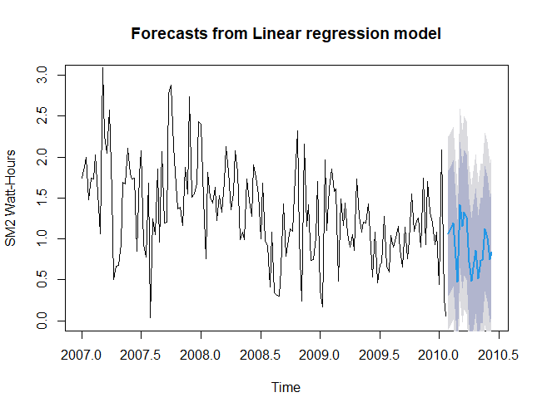
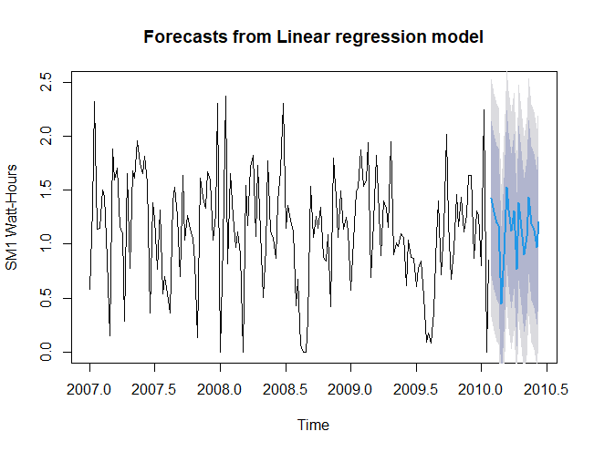
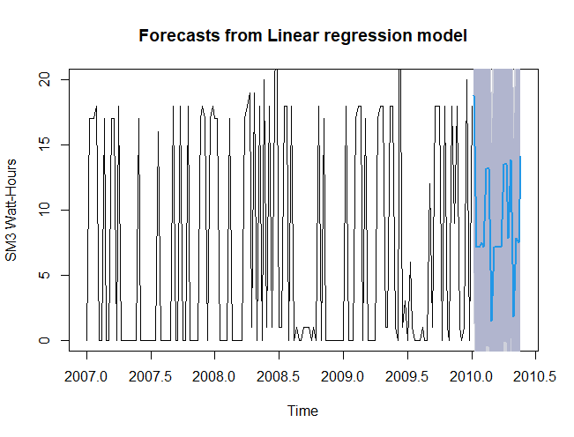
Linear Regression Forecasting

Slide 7
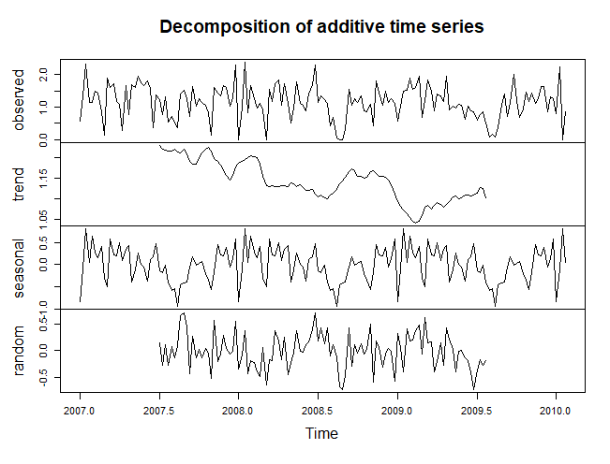
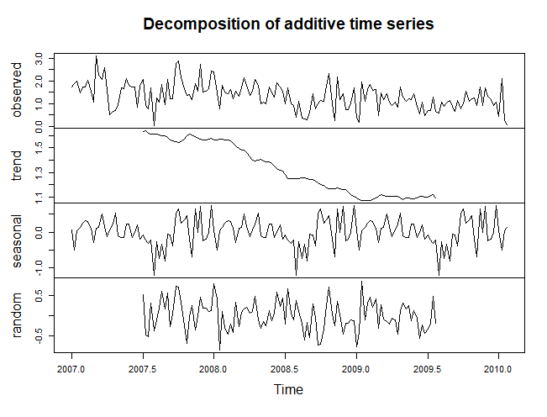
Component Decompositions
SM1
SM2

Slide 8
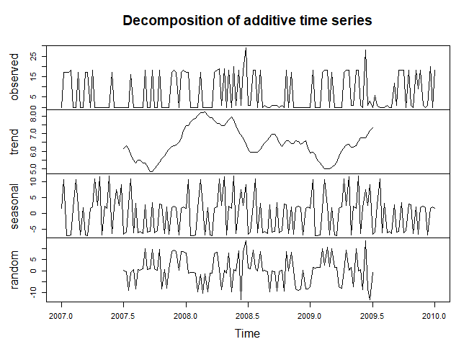
Component Decompositions
SM3
SM2 showed a clear trend decrease with time
Client perhaps reduced usage of washer/dryer
SM3 shows surprisingly weak/noisy seasonal trend
Improved if we use weekly averaging instead of sampling

Slide 9
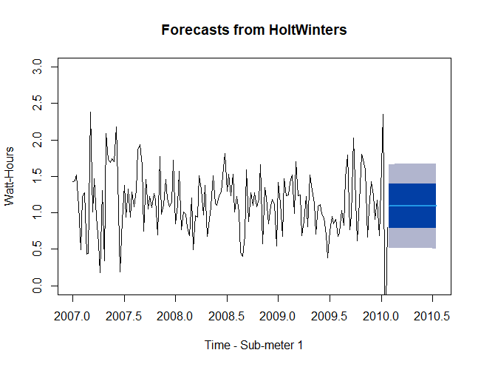
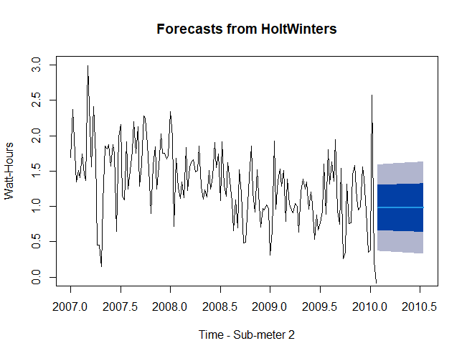
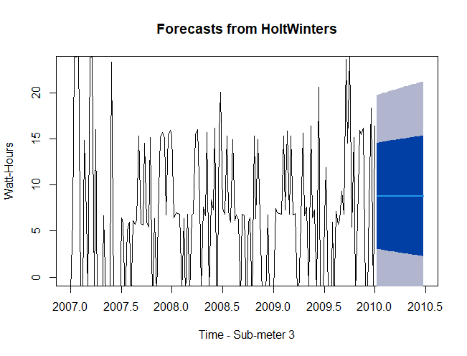
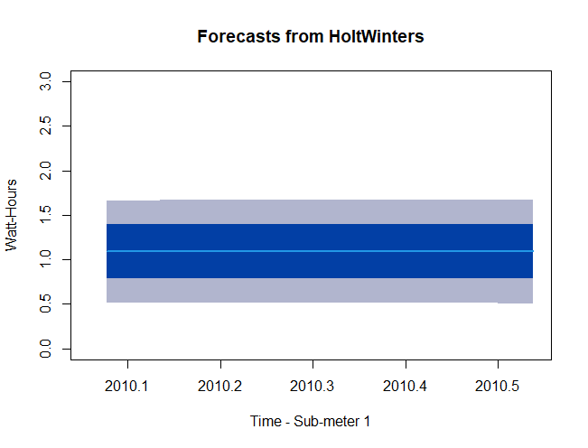
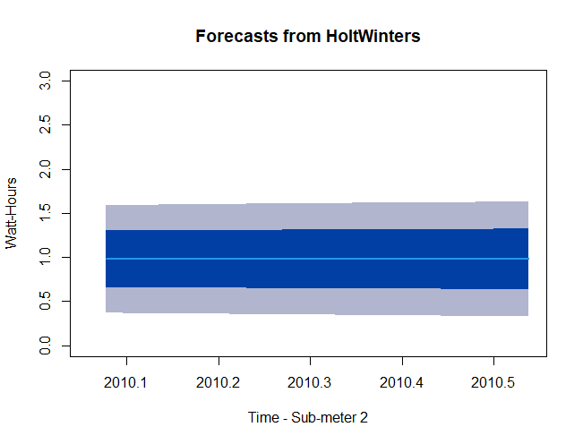
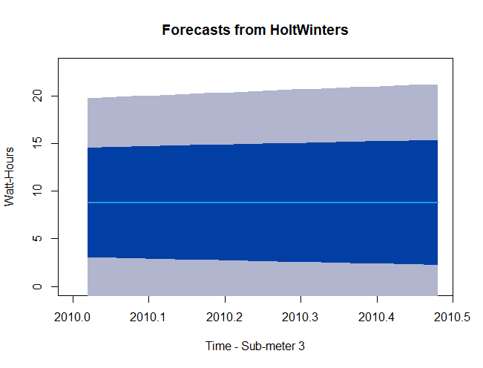
Holt-Winters Forecasting
50% and 80% Confidence Levels plotted
SM1
SM2
SM3
SM1
SM2
SM3

Slide 10
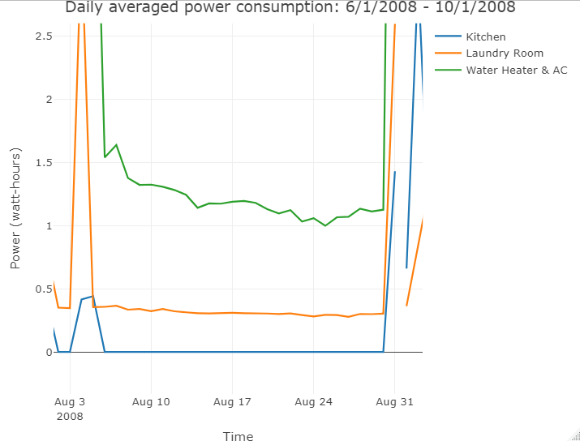
Modeled vs. actual usage in August 2008
August 2008
SM1
SM2
SM2
SM1
During Aug2008, SM1 and SM2 usages are well outside the 80% confidence ranges, indicating a significant deviation from previous trends
Further supports the client was not in the residence during this time frame

Slide 11
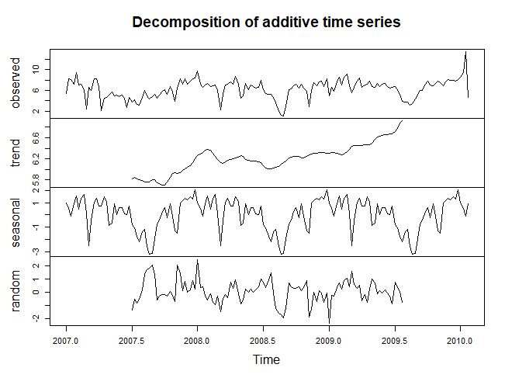
Business Recommendations
Combining weather and sunrise/sunset data could help in analyzing the seasonality and trend components of the AC/heater related data
SM3 decomposition shows lower seasonal usage in summer (plot on right)
Increasing the number of submeters in a residence would offer further insight into the details of a resident’s behavior
Sub-meters offer fine granularity, and future cases with tighter timelines in question could benefit
AC/Water heater consume significantly more energy annually than other appliances, and could be an opportunity for savings with more efficient units
Access to broad submeter usage data across a city could be useful in other data mining markets, such as targeted advertising
Identify meal times, bed times, and work schedules

Slide 12
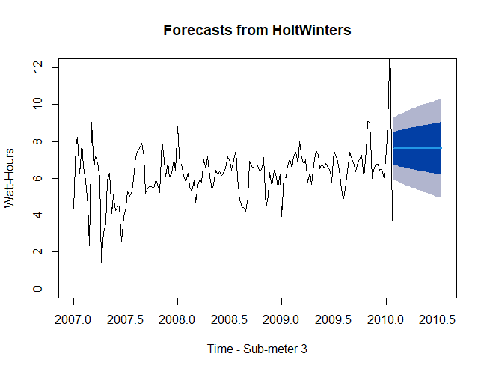
Lessons Learned
Sampled data is noisier than averaged grouped data for consumption data sets
Holt-Winters fails to integrate the SM2 downward trend in future forecasts
Manually adjusting parameters results in overfitting and a poor model
Using a weekly-averaged sample set produces much more controlled forecasts for SM3, as seen on right
Random sampling has negatively impacted our prediction capabilities
SM3 with this forecast would have supported the out-of-range claims for Aug2008

